Slide 1
10 ROSES FOR YOU

Slide 2
If you receive this …
It’s because you’re a special person

Slide 3
I send you 10 wishes for
2002

Slide 4

One rose for frienship

Slide 5

A second one for love

Slide 6

One for financial wealth

Slide 7
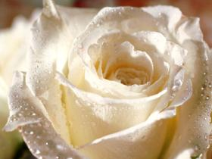
One for happiness

Slide 8
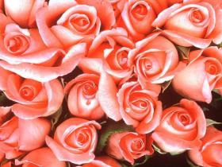
One for succes

Slide 9

One for knowledge

Slide 10

One for beauty

Slide 11

One for family

Slide 12
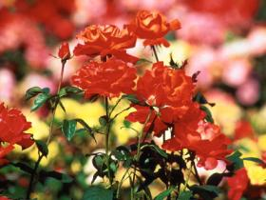
One for honesty

Slide 13
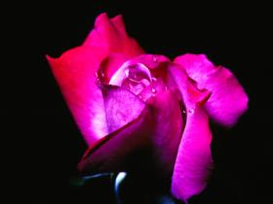
And the last one for a long and healthy life!

Slide 14
The original message says that:

Slide 15
You should not keep this message to yourself alone…
Send it on …

Slide 16
If you send it to 2 persons, your wish will be granted within the year

Slide 17
Send it to 5 persons …
And your wishes will come true …
… within 3 months…

Slide 18
To 15 and more … your dream will come true ...
… tomorrow already

Slide 19
Now I am not superstitious at all, but I do believe …

Slide 20
That it alway feels nice to be send flowers so …

Slide 21
Send these flowers to all persons you care about…

Slide 22
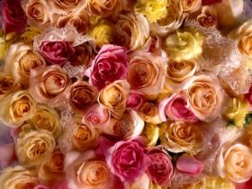
Thanks !

